Slide 1



CMR TECHNICAL CAMPUS
UGC AUTONOMUS
DEPARTMENT OF CSM
Image Forgery Detection Based on Fusion of Lightweight Deep Learning Models
PRESENTED BY:
1. NAME : BATHULA AKHIL VARDHAN REDDY
ROLLNO : 227R1A7373
2. NAME : BASUPALLY SATHWIK REDDY
ROLLNO : 227R1A7372
3. NAME : BANOTH NARENDER
ROLLNO :227R1A7371
UNDER THE GUIDANCE OF:
DR.K.MAHESH

Slide 2

ABSTRACT
EXISTING SYSTEM
DISADVANTAGES
PROPOSED SYSTEM
ADVANTAGES
HARDWARE REQURIMENTS
SOFTWARE REQURIMENTS
SYSTEM ARCHITECTURE
ANY QUERIES
UML DIAGRAMS
ALGORITHMS
DATASET DESCRIPTIION
OUTPUT SCREENSHOTS
PERFORMANCE METRICS
RESULT ANALYSIS
CONCLUSION
contents

Slide 3

ABSTRACT
Convolutional neural networks (CNNs) have received much attention in recent years and have influenced the field of image forgery detection.
Most image forgery techniques based on CNNs are limited to detecting a specific type of forgery, requiring a technique capable of efficiently and accurately detecting the presence of unseen forgeries.
The proposed model is a robust deep learning system for identifying image forgeries in the context of double image compression, using the difference between an image’s original and recompressed versions to train the model.
Images contain a wealth of information, and it is often required to enhance images to obtain additional information.
The proposed model is lightweight, faster than state-of-the-art approaches, and has an overall validation accuracy of 92.23%.

Slide 4
EXISTING SYSTEM
CNNs are non-linear interconnected neurons inspired by the human visual system that have demonstrated great potential in various computer vision applications, including image segmentation and object detection.
Image forgery is a serious problem, and detecting it is crucial since it is easily done using various tools available today.
When a portion of an image is moved from one to another, artifacts occur due to the differences in the images' origins, and CNNs can detect these artifacts.
The proposed approach involves training a CNN-based model to distinguish between genuine and fake images by utilizing the concept of how recompression affects forged regions differently due to the compression difference.

Slide 5
PROPOSED SYSTEM
The architecture of the proposed decision fusion is based on the lightweight deep learning models.
The lightweight deep learning models chosen are SqueezeNet [25], MobileNetV2 [22], and ShuffleNet [24]. The proposed system is implemented in two phases i.e. with pre-trained and fine-tuned deep learning models.
In the pre-trained models implementation, regularization is not applied and the pre-trained weights are used and for the fine-tuned implementation, regularization is applied to detect image forgery.
Each phase consists of three stages namely, data pre-processing, classification and fusion
In the data pre-processing stage, the image in the query is pre-processed based on the dimensions required by the deep learning models.
SVM is used for the classification of the image as forged or non-forged..

Slide 6
SOFTWARE REQUIREMENTS
SOFTWARE REQUIREMENTS
Operating system : Windows 7 Ultimate.
Coding Language : Python.
Front-End : Python.
Designing : Tkinter

Slide 7
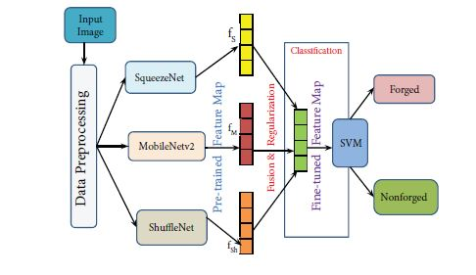
ARCHITECTURE

Slide 8
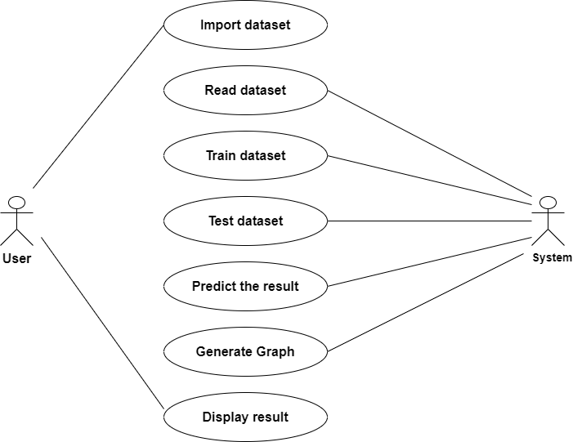
USE CASE DIAGRAMS

Slide 9
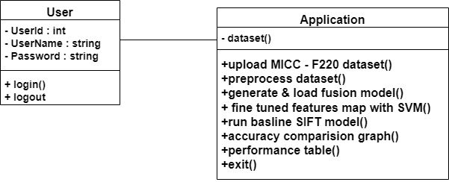
CLASS DIAGRAM

Slide 10
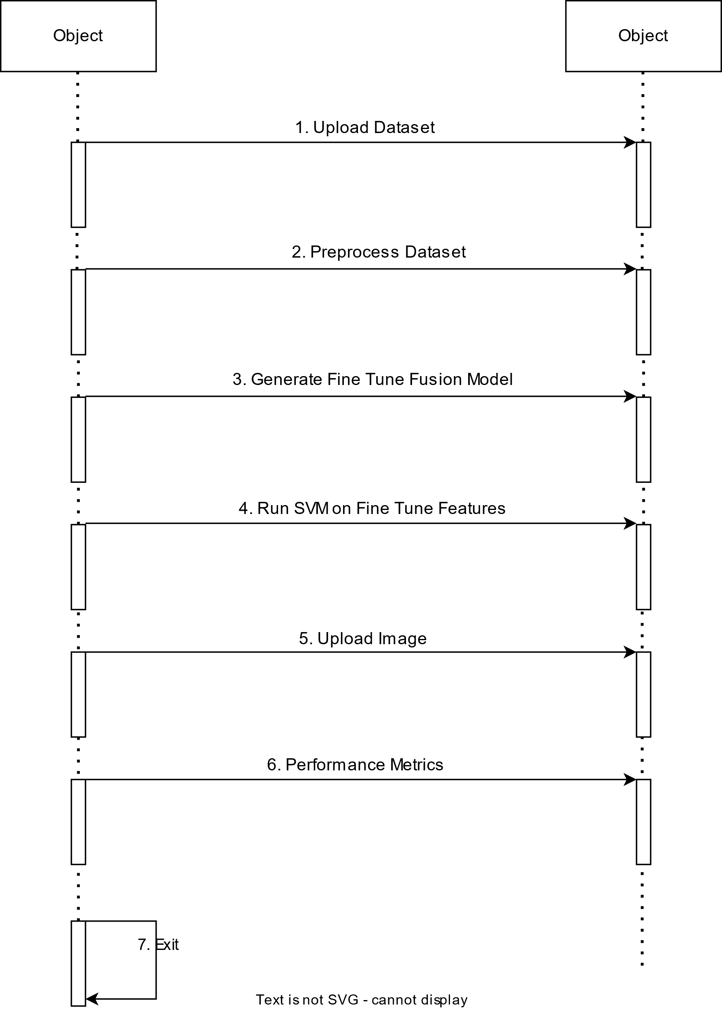
SEQUENCE DIAGRAM

Slide 11
SqueezeNet
MobileNetV2
ShuffleNet
SVM
Algorithms

Slide 12
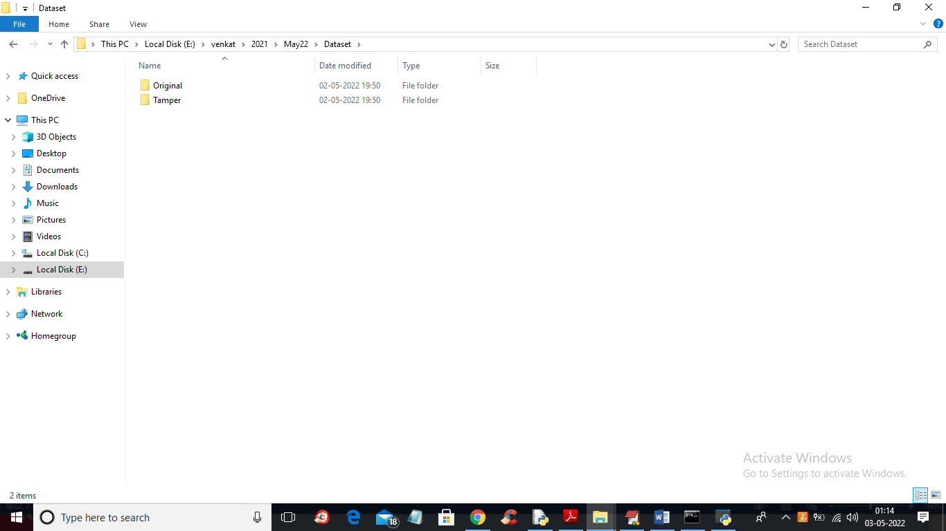
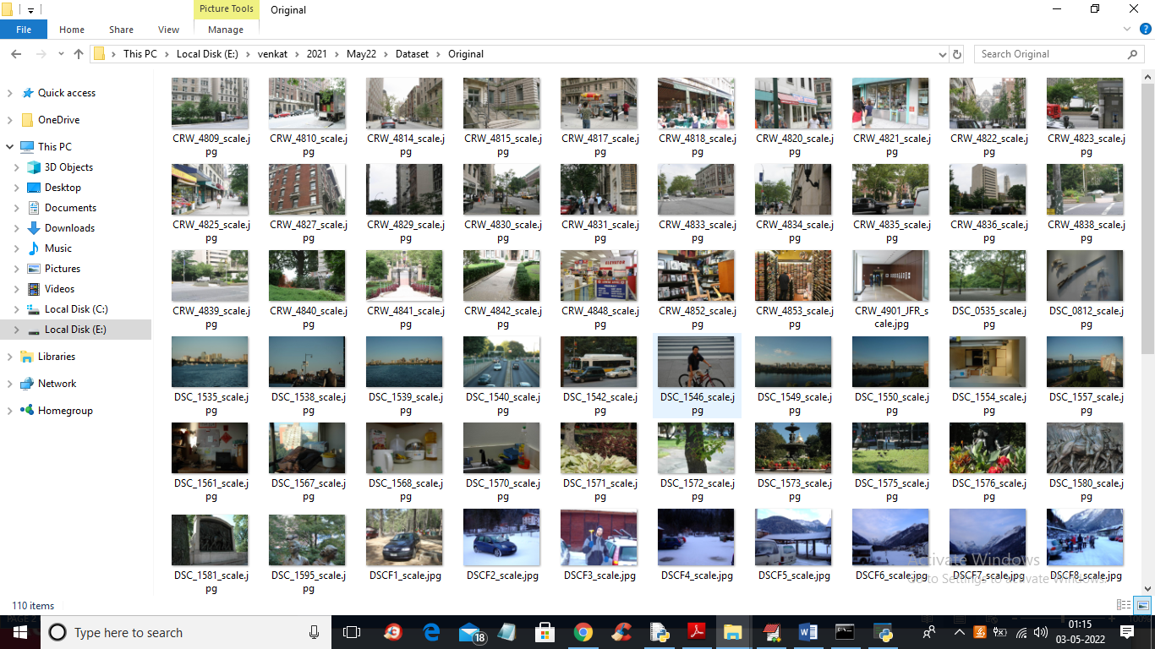
Dataset Description
In above screen in ‘Dataset’ folder we have 2 folders where one contains original images and other folder contains TAMPER or FORGE images and lets go inside any folder to view its images
So by using above images we will train all algorithms and calculate their performances

Slide 13
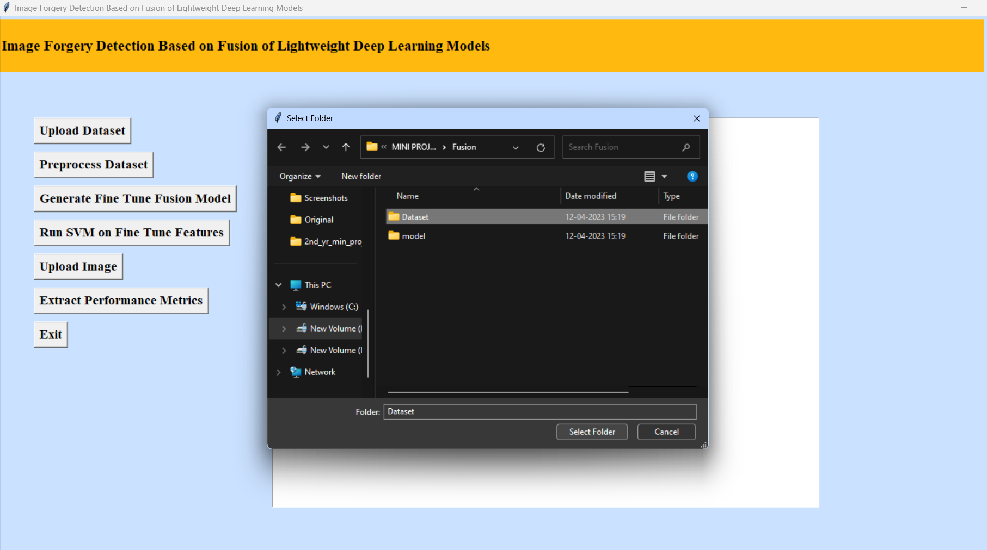
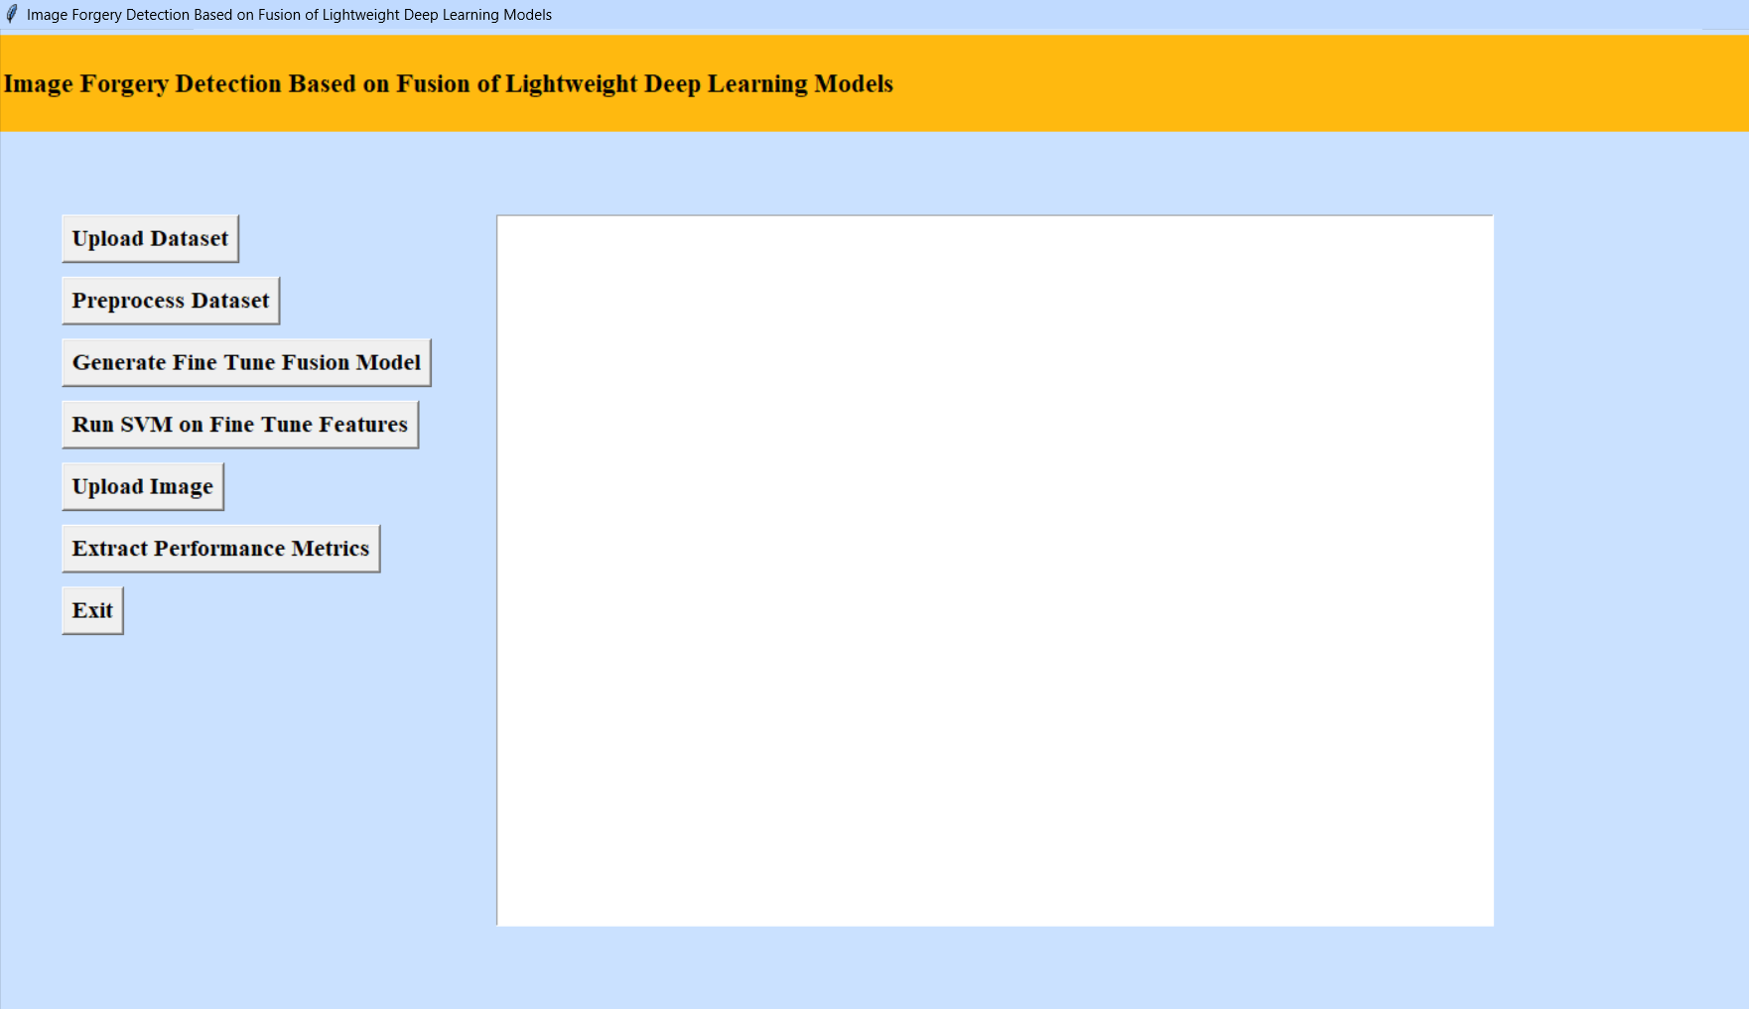
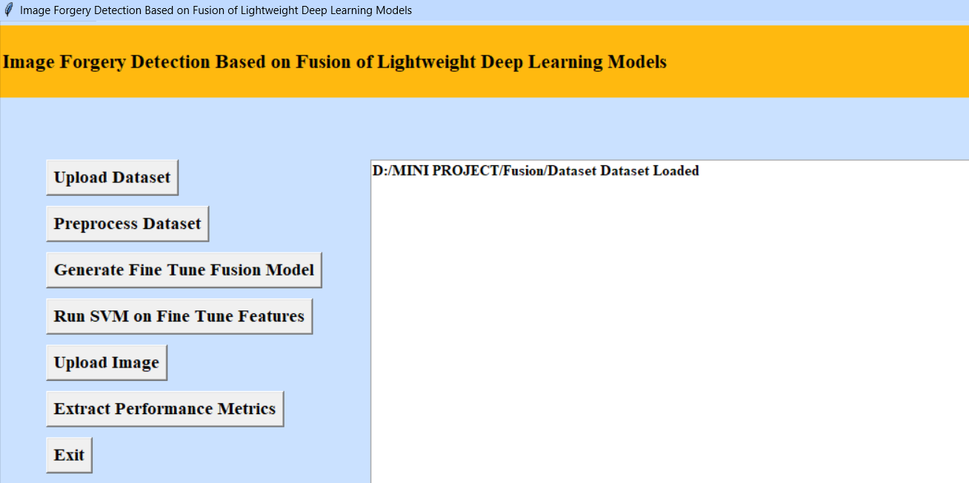
To run project double click on ‘run.bat’ file to get below output
In above screen selecting and uploading ‘Dataset’ folder and then click on ‘Select Folder’ button to load dataset and get below output
In above screen click on ‘Upload Dataset’ button to upload dataset
In above screen dataset loaded and now click on ‘Preprocess Dataset’ button to read all images and normalize them and get below output

Slide 14
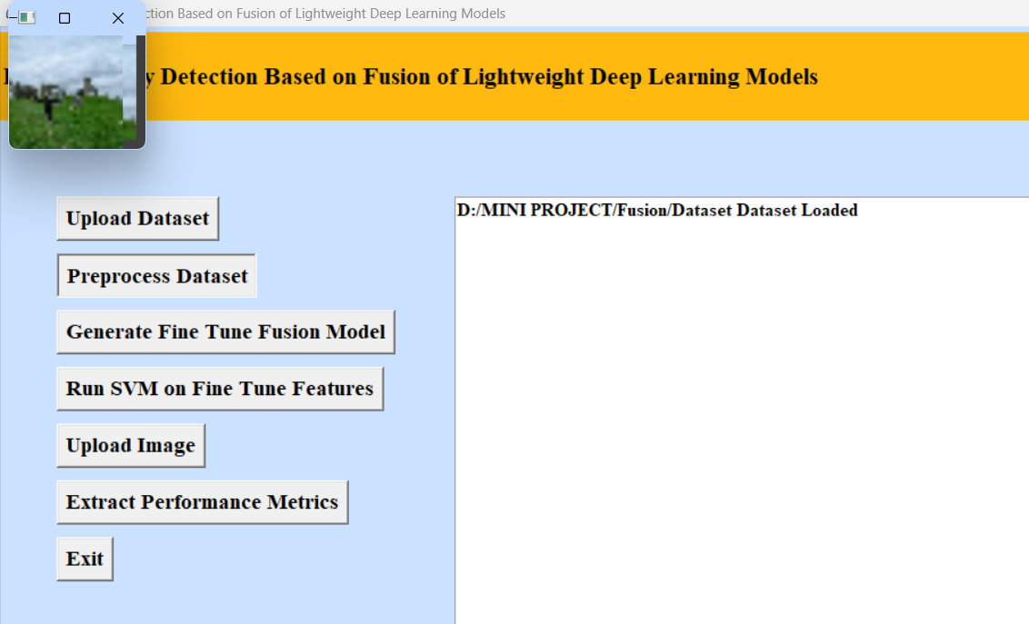
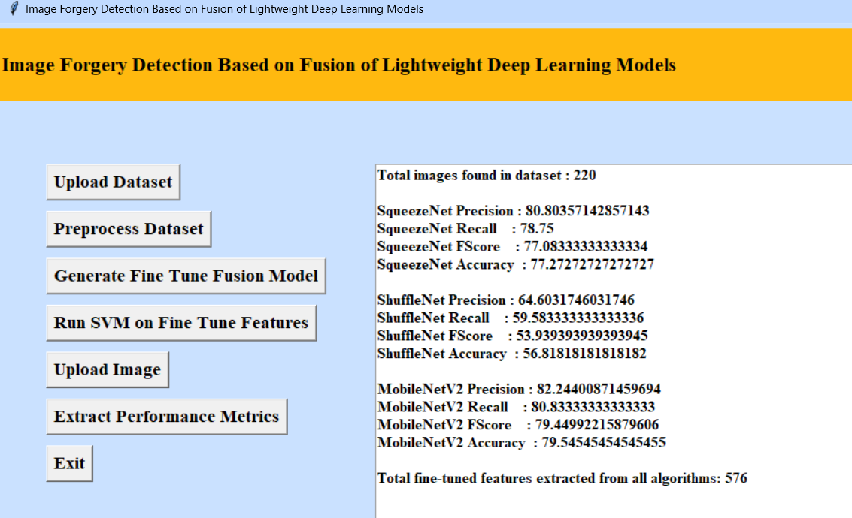
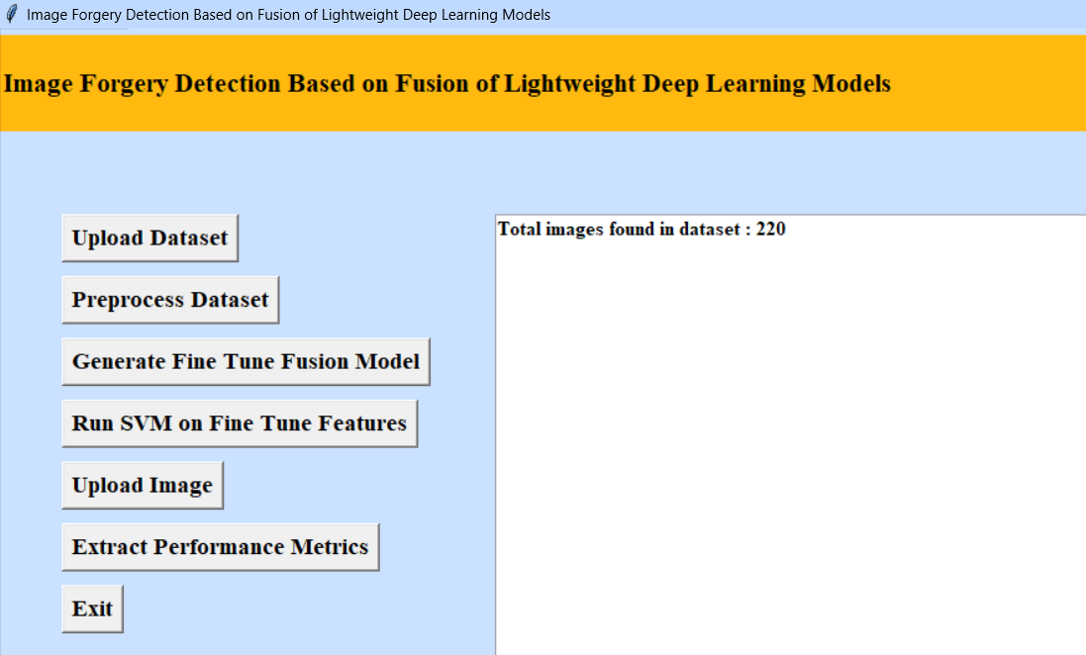
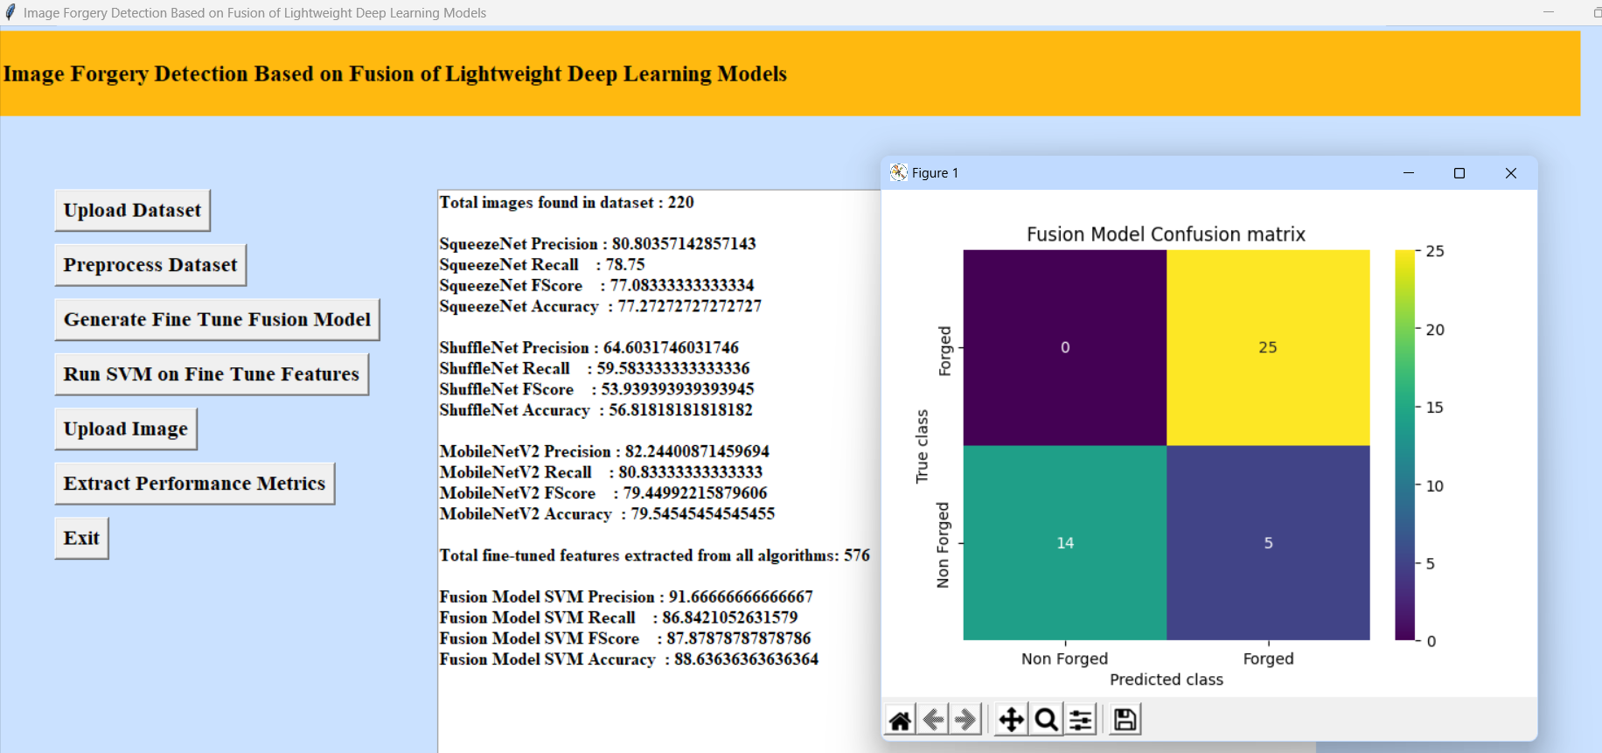
In above screen we can see accuracy of all 3 algorithms and then in last line we can see from all 3 algorithms application extracted 576 features and now click on ‘Run SVM on Fine Tune Featurces’ to train SVM with extracted features and get its accuracy as fusion model
In above screen all images are processed and to check images loaded properly I am displaying one sample image and now close above image to get below output
In above screen we can see dataset contains 220 images and all images are processed and now click on ‘Generate Fine Tune Fusion Model’ button to train all algorithms and then extract features from them and then calculate their accuracy

Slide 15
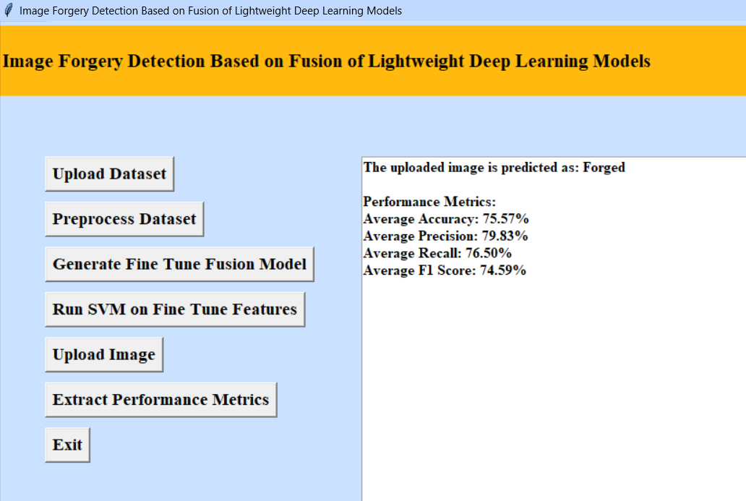
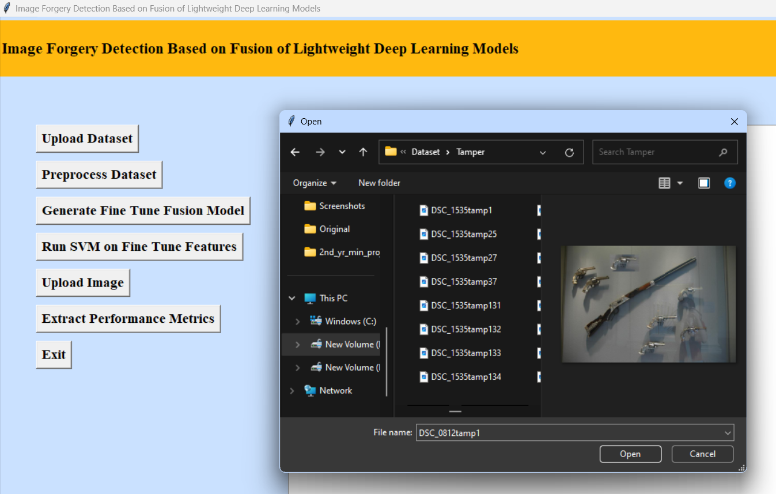
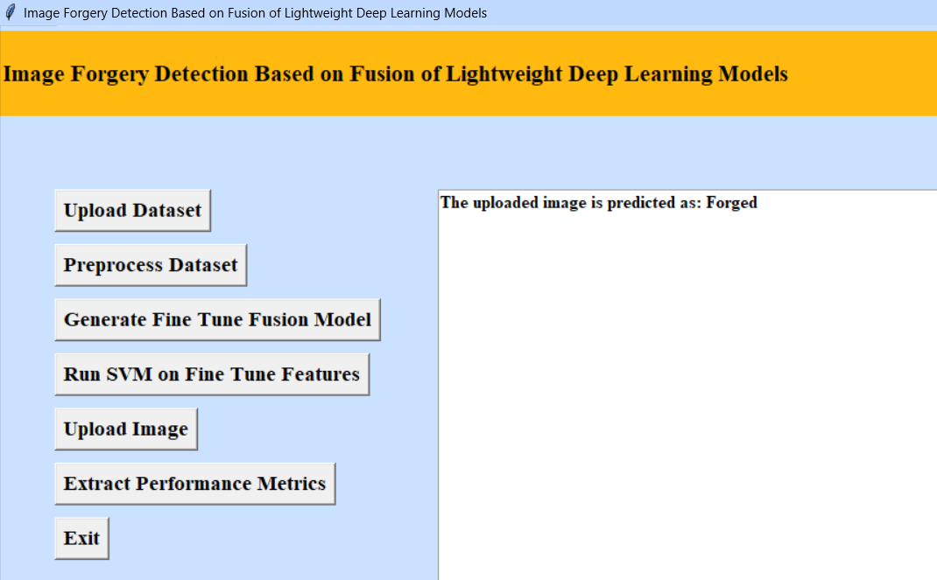
In above screen with Fine tune SVM fusion model we got 95% accuracy and in confusion matrix graph x-axis represents PREDICTED LABELS and y-axis represent TRUE labels and we can see both X and Y boxes contains more number of correctly prediction classes. Now click upload image to get below ouput
Now click on the performance metrics to get below output
We will get Average Accuracy, Average Precision, Average Recall and Average F1 Score of 3 algorithm Accuracy :- Accuracy measures the proportion of correct predictions among the total number of predictions made by a model.
Precision:- Precision is the ratio of correctly predicted positive observations to the total predicted positive observations.
Recall :- Recall is the ratio of correctly predicted positive observations to all observations in the actual class.
F1 score:- F1 Score is the harmonic mean of precision and recall, providing a single metric that balances both precision and recall.
Select the image from data we upload to check wheather the image is fogery or not. After selecting you will get following output.

Slide 16
Performance metrics

Slide 17
Result analysis
Accuracy and Precision: Highlight the accuracy of your detection method in identifying forged images and the precision in distinguishing between different types of forgeries.
False Positive Rate: Discuss the rate at which your system incorrectly identifies authentic images as forged (false positives) and how you mitigate this.
Detection Speed: Describe the speed at which your system analyzes images for forgeries, emphasizing efficiency in real-time or batch processing scenarios.
Robustness to Manipulation Techniques: Highlight the robustness of your detection method against various manipulation techniques such as copy-move, splicing, or blending, demonstrating its capability to detect a wide range of forgeries effectively.

Slide 18

CONCLUSION
Fusion of lightweight deep learning models is a powerful approach for image forgery detection. This technique combines the features extracted from multiple lightweight deep learning models, which can improve the accuracy of image forgery detection.
Fusion of lightweight deep learning models can be used in a variety of applications, from medical imaging to social media, to detect manipulated images and protect users from malicious content and fake news.

Slide 19
FUTURE SCOPE
Real-time and Edge Device Deployment: There is a growing need for lightweight models that can provide real-time forgery detection, particularly for applications like social media moderation and edge devices. Future work will optimize and deploy these models to run efficiently on resource-constrained hardware.
Ethical and Privacy Considerations: As forgery detection technology becomes more prevalent, it's essential to address ethical and privacy concerns. Future research and development will prioritize responsible AI practices, ensuring that these systems respect individuals' privacy and adhere to ethical guidelines and legal regulations.
Multimodal Fusion for Improved Accuracy: Future research will focus on combining multiple data sources, such as image content, metadata, and sensor data, to enhance forgery detection accuracy. Lightweight models will be developed to efficiently integrate information from different modalities.

Slide 20


